Slide 1

University of Chittagong
Introduction to Loops
Dr. Abu Nowshed Chy
Department of Computer Science and Engineering
Faculty Profile

Slide 2
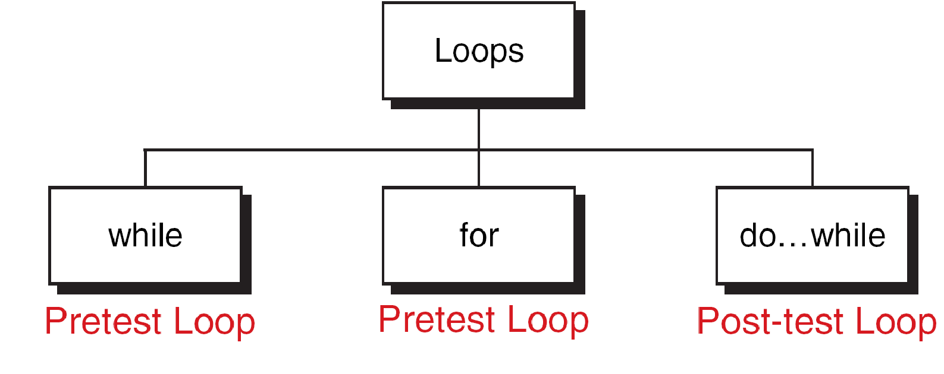
Loop
Loop:
A loop is a sequence of statements that is continually repeated until a certain condition is reached.
Types of Loops:
2

Slide 3
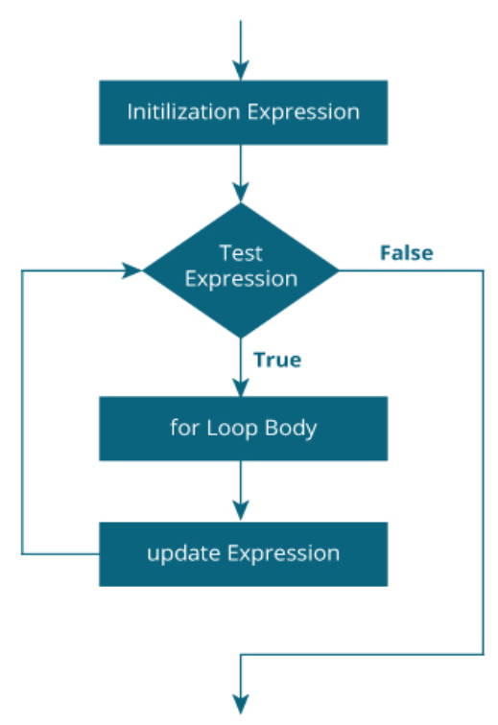
“For” Loop
for(initialization; test condition; increment)
{
body of the loop
}
General Form
Flow Chart
3

Slide 4
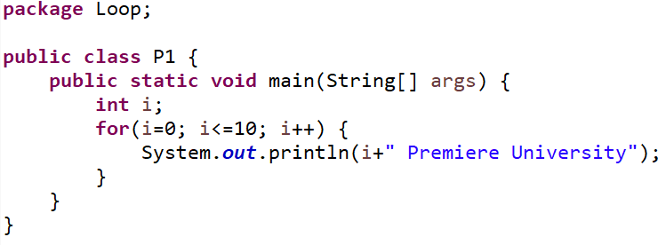
Print Text Message Multiple Times
For Loop
4

Slide 5
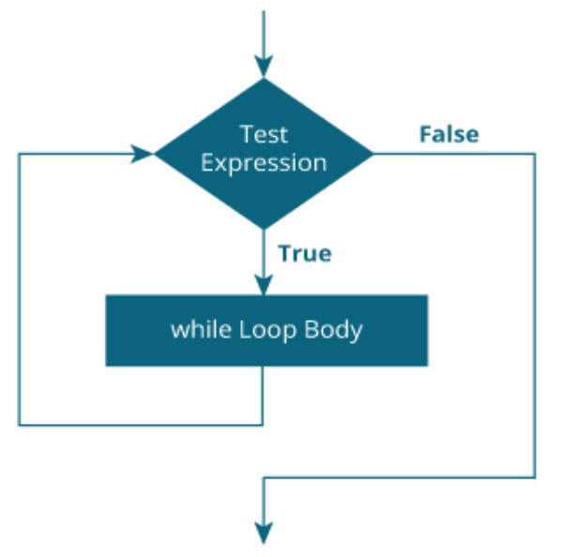
“While” Loop
while (test condition)
{
body of the loop
}
General Form
Flow Chart
5

Slide 6
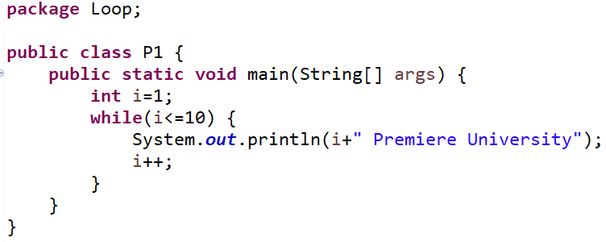
Print Text Message Multiple Times
While Loop
CU
6

Slide 7
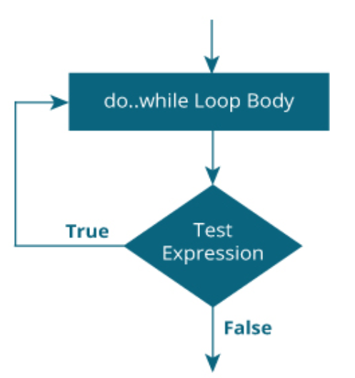
“Do-while” Loop
do
{
body of the loop
}
while (test condition)
General Form
Flow Chart
7

Slide 8
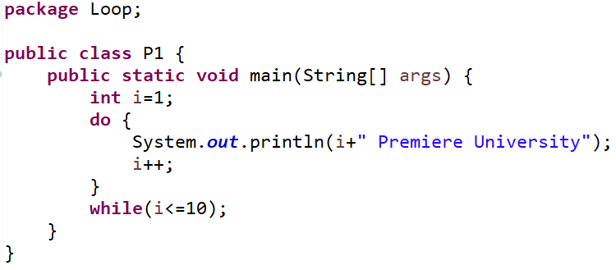
Print Text Message Multiple Times
Do-while Loop
8

Slide 9
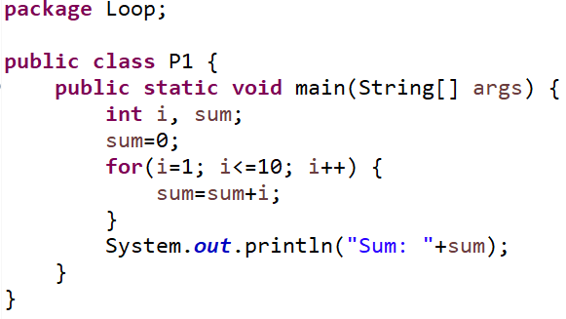
1 + 2 + 3 + 4 + 5 + … …
9

Slide 10
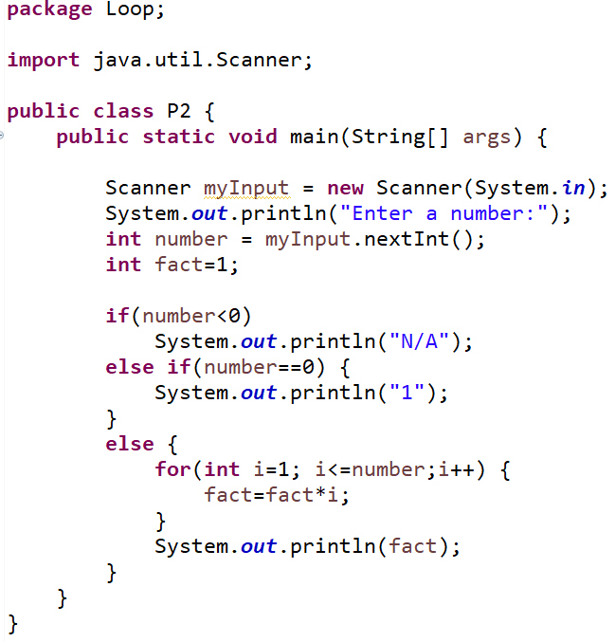
Factorial
10

Slide 11
Factors
Program: Find all factors of a natural number
n=50
Factors of 50 are 1, 2, 5, 10, 25, 50
11

Slide 12
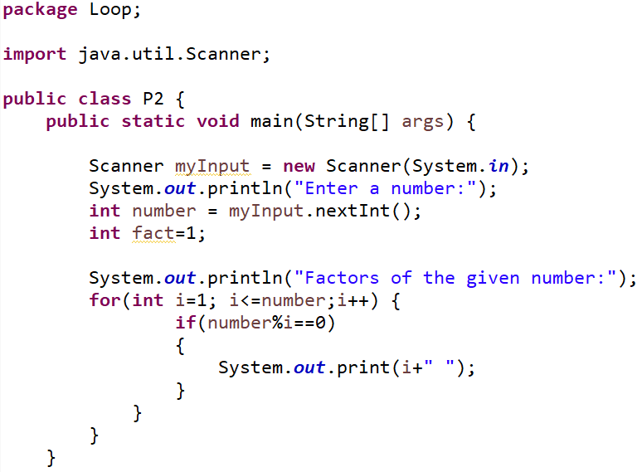
Factor
12

Slide 13
Practice Task
Display the sum of the following series:
a. 1+3+5+ …………………….. + n (odd)
c. 2+4+6+ …………………….. + n (even)
Find the numbers between 100 and 200 that
can be divided by 17.
Find the sum of all integers greater than 100
and less than 200 that are divisible by 7.
13

Slide 14

14

